Slide 1
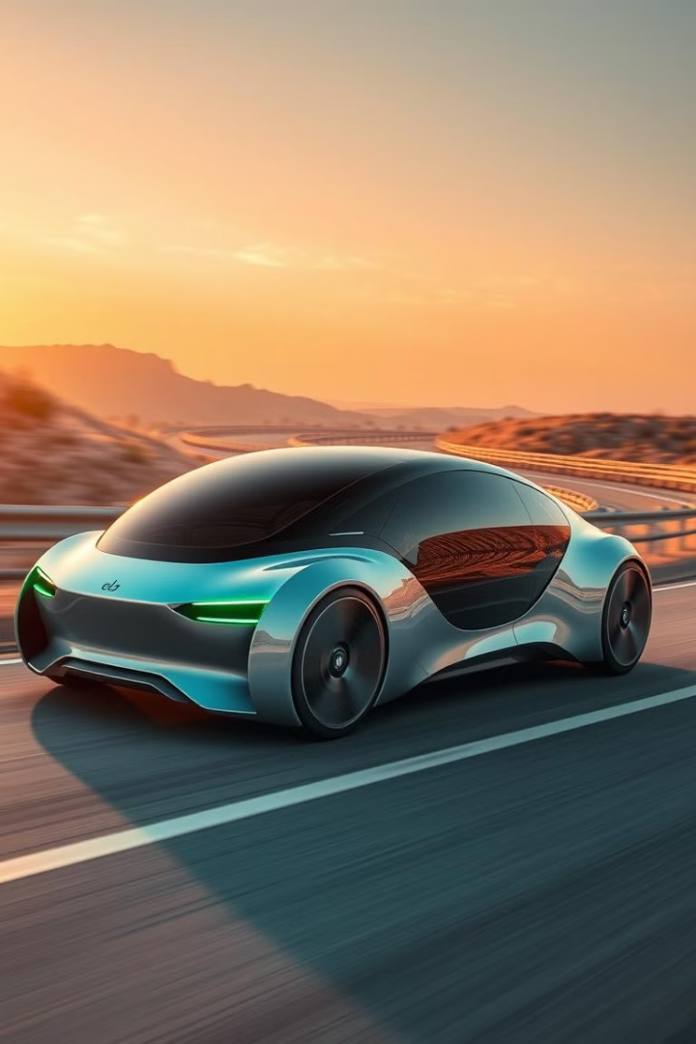
ESP8266 Autonomous Car Project
This presentation outlines the development of an ESP8266-controlled autonomous car. The project utilizes sensor data for obstacle avoidance and Wi-Fi for remote commands. We'll explore the system's inputs, outputs, hardware, and functionality.

Slide 2
Project Team
Amina Elshabandy
Nada Haytham
Esraa Salah Eldeen

Slide 3
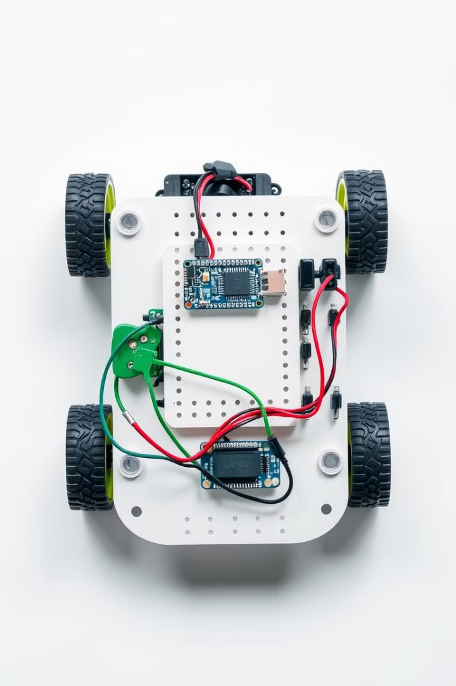
ESP8266 Autonomous Car: Overview
1
Wi-Fi Controlled
2
Motor Driver
Operated via ESP8266 module.
L298N controls car movement.
3
Obstacle Avoidance
Uses an ultrasonic sensor.
The ESP8266 Autonomous Car navigates its environment using an ultrasonic sensor. Controlled by an ESP8266 Wi-Fi module and an L298N motor driver, it moves forward while avoiding obstacles.

Slide 4
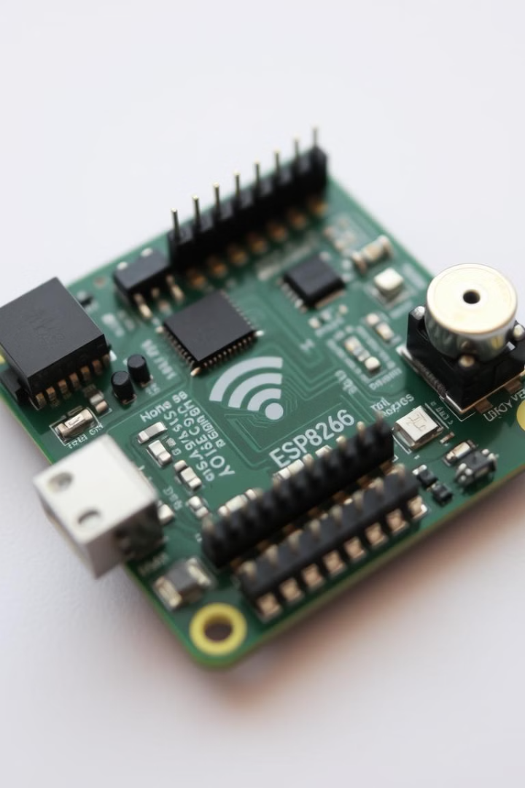



Project Inputs
Sensor Data
User Commands
Wi-Fi Signal
Real-time input from ultrasonic sensor.
Remote commands for direction and speed.
Wi-Fi network connecting the car and user.
The project relies on sensor data from its surroundings. User commands are sent via Wi-Fi to control the car. The system processes these inputs for autonomous navigation.

Slide 5
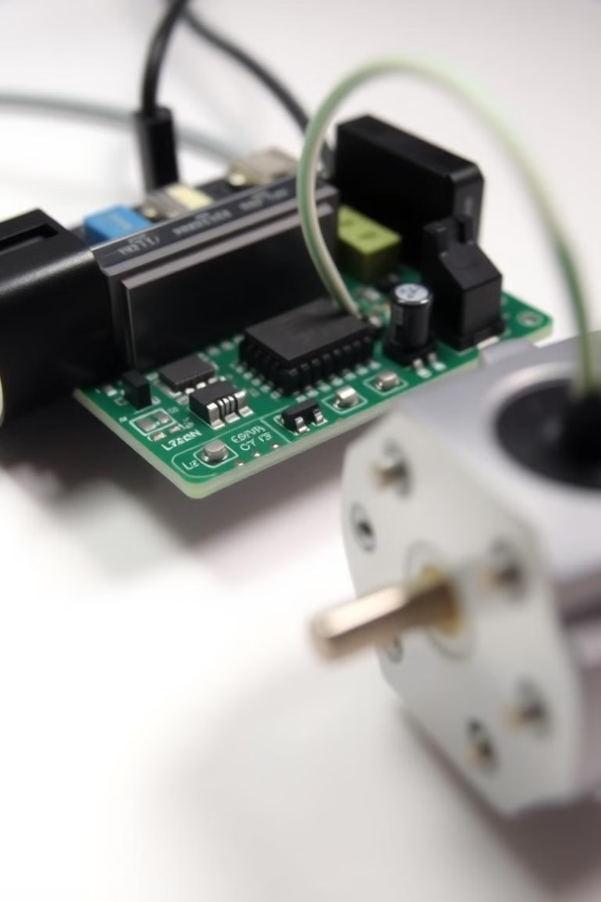
Project Outputs
Motor Controls
Status Updates
Precise control of motor speed and direction.
Real-time status feedback to the user.
The car outputs precise motor controls for movement. Status updates inform the user of the car's current state. The car stops upon obstacle detection.

Slide 6






System Flowchart
Start
Initialization of the system.
Sensor Input
Ultrasonic sensor detects distance.
Data Processing
ESP8266 processes data and commands.
Motor Control
L298N drives motors accordingly.
Obstacle Avoidance
Car adjusts direction if needed.
End
Continuous loop for autonomous navigation.
The system flowchart illustrates the flow from sensor input to motor output. The ESP8266 processes data, controls the motors, and avoids obstacles. The process repeats for continuous autonomous navigation.

Slide 7
Obstacle Avoidance
Ultrasonic Sensor
Algorithm
Motor Adjustment
Measures distance to obstacles.
Calculates optimal turning angle.
Adjusts motors to avoid collision.
The ultrasonic sensor is crucial for obstacle avoidance. The sensor measures the distance, calculates the angle to turn and adjusts the motor to avoid collision. The car navigates smoothly in dynamic environments.

Slide 8
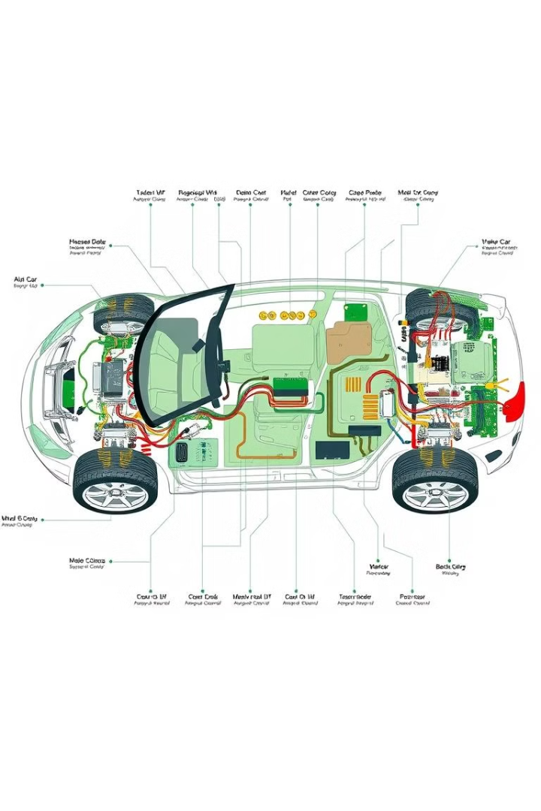
Hardware Components
1
ESP8266
Wi-Fi module for control.
2
L298N
Motor driver for movement.
3
Ultrasonic Sensor
Distance measurement.
4
DC Motors
Provide movement to the car.
The hardware includes an ESP8266 Wi-Fi module for control. The L298N motor driver controls the DC motors. The ultrasonic sensor enables obstacle avoidance. These components enable autonomous navigation.

Slide 9

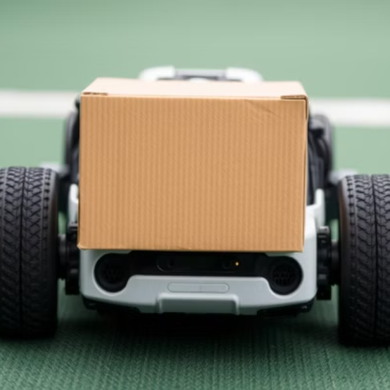
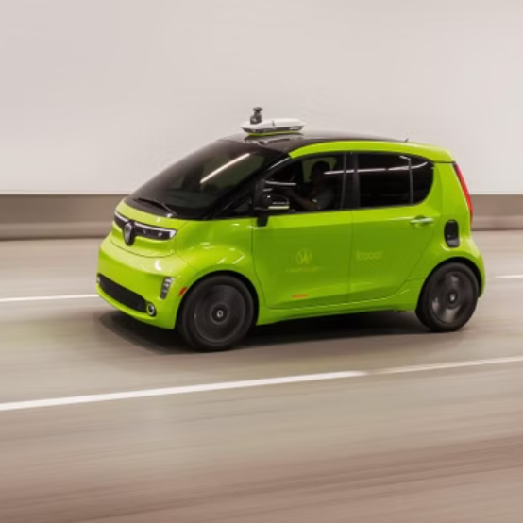
Autonomous Car in Action
Watch the ESP8266 Autonomous Car in action! See it navigate a course, avoid obstacles, and respond to commands. Experience the result of our hard work and ingenuity.

Slide 10



Summary & Future
Enhancements
1
More features to be developed.
Key Takeaways
2
Autonomous navigation success.
Summary
3
Project completed.
The ESP8266 Autonomous Car project demonstrates successful autonomous navigation. Key takeaways include effective sensor integration and control. Future enhancements could include more sensors.

